Slide 1
‘PUSH-TO-WEB’ AND ADDRESS BASED ONLINE SURVEYING (ABOS)
Joel Williams, Kantar Public UK
November 2017

Slide 2
What/why ‘push-to-web’
What is push-to-web surveying?
Sample is contacted ‘offline’ (by post, by telephone or in-person) and asked to complete a questionnaire online while other response modes are downplayed or offered only after online non-response
Why push people to respond online?
(In some circumstances) online completions cost less than other types
More convenient for some (no need for interview appointments, questionnaire can be done bit by bit)
Can use visual prompts (incl. pictures and even video, and ‘dynamic’ question design) that are logistically difficult to do with paper or by telephone
Seems ‘modern’ (or at least not as antiquated as interviewing)…

Slide 3
Varieties of ‘push-to-web’ designs
Contact approach depends on what is known about the sampled household or individual
Almost always written contact rather than expensive personal contact
Contact mode can include mailed letters, emails, SMS text messages, social media posts
All available contact modes tend to be used and typical to send 2-3 reminders as most research suggests that maximising the number of contact opportunities maximises the probability of response
Some will regard this as ‘bombardment’, potentially reducing response probabilities to other modes in the sequence or to future waves of the study (if longitudinal in form)
Not much evidence (I’ve seen) for negative effects but push-to-web designs are fairly new to social research so absence of evidence should not be taken as evidence of absence!

Slide 4
‘Push-to-web’ surveys in the UK: longitudinal studies
Major longitudinal surveys:
Understanding Society (wave 7 onwards) – WEB>FTF
NCDS (age 55 sweep) – WEB>TEL
Next Steps (waves 5-8 of original cohort (ages 18, 19, 20, 25) and waves 4-7 of new cohort (17, 18, 19, 20)) – WEB>TEL>FTF
Mixed-mode studies are more complex to manage than single mode studies – and data more complex to use
Measurement effects are sometimes substantial which makes causal inference more difficult
Data collection cost savings in WEB>FTF designs can be modest because interviewers still travelling to sample areas and have to contact/persuade the harder-to-get cases

Slide 5
‘Push-to-web’ surveys in the UK: cross-sectional studies
Name-based samples
Personally addressed contacts – no additional sampling, (probably) better chance of response, stronger data safeguards, potential for tailored communications
Individual-level data on sample frame opens up responsive design options, powerful weighting strategies
E.g. Wellcome Trust Science Education Monitor (aged 14-18), DfE’s ‘Pupils & Parents’ survey
Address-based samples
Same sparse but comprehensive sample frame as for general population interview surveys
Small area data or imputed (pseudo)address level data can be utilised for responsive design
Kantar developed this in UK and calls it ABOS – ‘Address-Based Online Surveying’…

Slide 6
What is ABOS?
Basic design:
Stratified random sample of addresses is drawn from the Royal Mail’s postcode address file
Invitation letter is sent to ‘the residents’, containing username(s) and password(s) plus survey website url
Device-agnostic questionnaire (nowadays this means designed for mobile)
Lots of variants possible!
Within-address sampling (take one at random, take all, take up to n?)
Reminder communications (letter or postcard? responsive design? evolving message strategy?)
Incentives (what value? should they be targeted?)
Complementary modes (paper option? separate interview survey?)
Notes:
*Lots of variants possible…
What complementary modes to use
Number and type of reminders
Value and type of incentive
Contact and messaging strategy

Slide 7
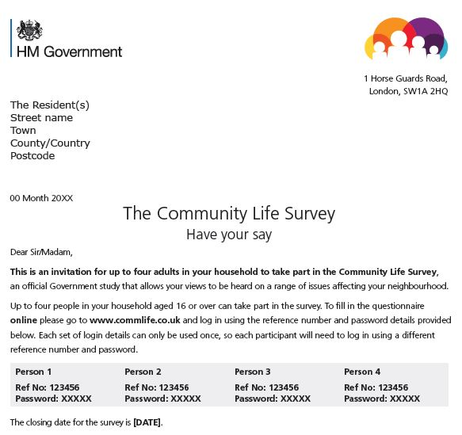
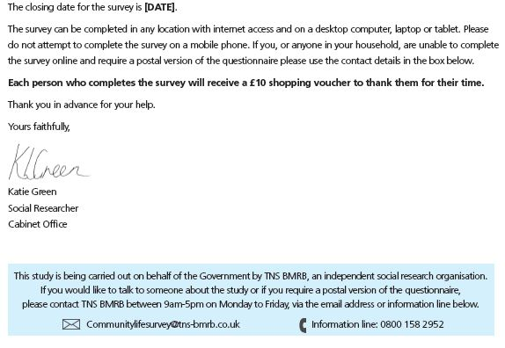
Example letter from 2016-17 Community Life Survey (upper/lower parts of p1)

Slide 8
Why ABOS?
Originally conceptualised as lower cost alternative to increasingly difficult dual-frame RDD
More flexible with regard to both size and shape than interview surveys
Builds upon ABS designs in the US and push-to-web strategies utilised on many surveys
First test with face-to-face interview survey Community Life in 2012 (Cabinet Office, now DCMS)
Now used as the sole data collection method for Community Life
Kantar has used it for six other clients and Ipsos MORI uses a variant for Sport England’s Active Lives
Notes:
*More flexible… than interview surveys…
Inc. panels that have been recruited from interview surveys
Largest in UK has <150,000 annually
We’ve done more than a dozen hyperlocal surveys (e.g.300 respondents from streets around Anfield stadium)
*First test…
(Although intended as an alternative to RDD…)

Slide 9
Questions about ABOS (see also article in SRA Social Research Practice Vol 3)
Q1: If the sample is of addresses, how do you convert this into a sample of individuals?
Q2: How do you verify that the data is from the sampled individual(s)?
Q3: How do you cover ‘offline’ individuals?
Q4: What RR does the ABOS method get and what is the impact of the design features you have tested?
Q5: How does response rate vary between subpopulations, and what (if anything) can you do about it?
Q6: What evidence do you have for non-response bias?
Q7: How much does it cost?

Slide 10
Q1: How do you convert a sample of addresses into a sample of individuals?
No control over which household in multi-household addresses (but few of these in England)
Don’t really know who lives in each household (electoral roll is partial/dated; use of other databases restricted)
Initially tested quasi-random last/next birthday methods to select respondent but substantial non-compliance
ESS/NatCen tested ‘proper’ random-one sampling but experienced similar problems
Tested ‘all individuals’ method to overcome problem
Clustered data but statistical value similar to sample that requires within-household sample weights
Lower printing/postage costs
Risks of ‘contamination’ (like most whole-household surveys) and of multiple completions by one resident
Community Life estimates are not systematically different under ‘all individuals’ design than under true ‘random one’ design…
Notes:
*Firstly, something we can’t do anything about… (‘few’ = 2%)
*Non-compliance = 1/4 to 1/3 respondents not the right ones; our scientific concerns just look pernickety to normal people!
*Proper random sampling = any adult completes online household roster and is then asked to hand over to selected adult (if different)
*Clustered data…
Within-household sampling weights would be required if random-one design used (no design effect difference so clustering not a big issue)
*Risks of contamination…
First person’s experience influences whether and how next person responds

Slide 11
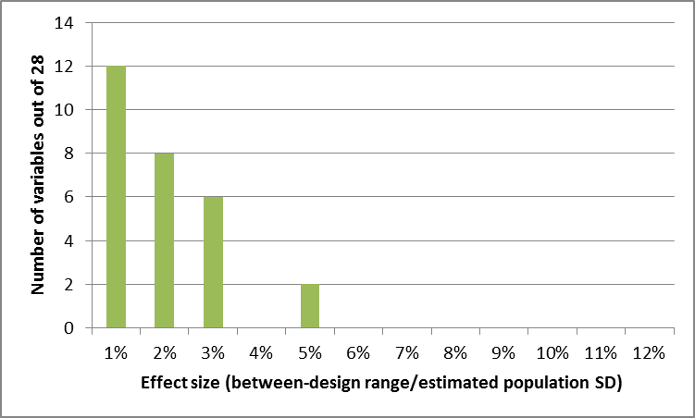
Standardised difference in survey estimates between the ‘all-individuals’ and ‘random-one’ designs (28 principal variables)
Notes:
*Difference in estimate from the implemented design (all individuals) and a post hoc random sample design, in which one individual is drawn from the household grid and only their data (if we have it) is used.
*Effect size is this difference divided by a pooled estimate of the population standard deviation. A way of dealing with questions that have different population variances.
*So, given they are all proportion estimates, the effect size is always at least double the difference in estimates.
*Both samples have been calibrated to the same set of population totals.
*I would describe these as tiny effects…

Slide 12
Q1: How do you convert a sample of addresses into a sample of individuals?
ONS developing a household/person level admin database but not ready yet & use will be highly restricted
So new options with postcode address file being tested:
Single username/passcode for ‘any’ individual in household to use
Enters household grid data (name, age, gender, relationship data & any other eligibility criteria)
Original username/passcode can be used N additional times (N = number of additional eligible individuals)
Or new usernames/passcodes generated for each additional eligible individual
Option 1: 1st respondent notes them down and passes them on;
Option 2: 1st respondent supplies e/m-contact data for these individuals so unique link can be sent directly;
Option 3: new letters are posted to each individual (or one randomly sampled)

Slide 13
Q2: How do you verify that the data is from the sampled individual(s)?
Verification of self-completion survey data must be proportionate to avoid exploding budget
Far less control than with interview surveys
Strategy 1: Stress the importance of data validity; explain that verification procedures are used (w/o specifying)
Strategy 2: Control the release of usernames/passcodes within each sampled household (noted earlier)
Strategy 3: Construct algorithm to weed out completed questionnaires that fail on set (multiple) criteria
Algorithm based on suggestions from the literature but survey-level identification matrix is unspecified
<5% exclusion rate for Community Life; 2-10% on other surveys, depending on edit criteria
Live question whether combination of these strategies is sufficient even if it is proportionate (i.e. what is risk to inference of including bad data?)

Slide 14
Q3: How do you cover offline individuals?
Based on 2015-16 data, 13% of the adult population in GB has not used internet in last 12 months: effectively not covered by an online survey method
Shrinking but particularly distinctive with respect to birth cohort and educational level (see chart)
Government studies can’t usually miss them out!

Slide 15
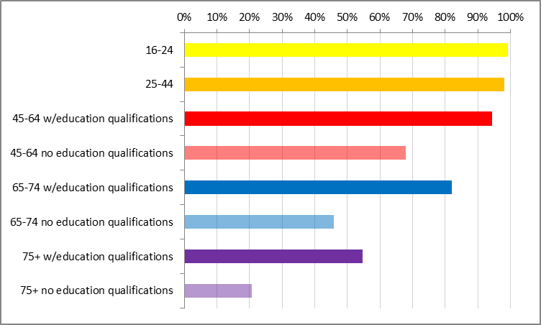
Have you used the Internet at home or elsewhere in the last 12 months? (CSEW, 2015-16)
Notes:
*This chart demonstrates that internet usage is near universal among the under 45s but above that is correlated with educational level (although this simple chart simply divides subpopulations by whether or not they have any qualifications)

Slide 16
Q3: How do you cover offline individuals?
Based on 2015-16 data, 13% of the adult population in GB has not used internet in last 12 months: effectively not covered by an online survey method
Shrinking but particularly distinctive with respect to birth cohort and educational level
Government studies can’t usually miss them out!
Most ABOS studies use paper option (usually ‘on request’ and in selected 2nd reminder packs)
Paper brings in different demographic types but will not necessarily improve overall sample balance
Paper option enforces simple questionnaire design or version limited to headline measures
Alternative is (costly) parallel interview survey limited to offline/not-very-online
Impact on total population estimates of alt.mode data not always substantial (see chart) but think about subpopulations too…

Slide 17
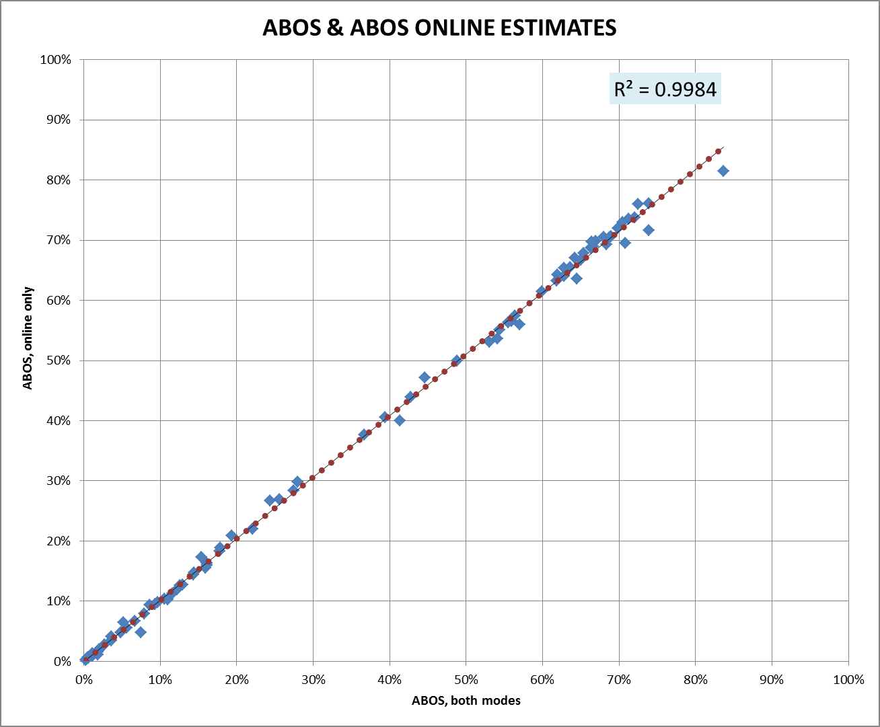
What difference does paper make to the estimates? (example from 2017; paper = 30% of data)
Notes:
*In this example, paper may have ensured formal population coverage but its inclusion hardly changes the results at all.
*Potential for bigger differences at subpopulation level but these can be hard to detect, given greater random sampling error.

Slide 18
Q4: What response rate does the ABOS method get?
Response rate depends on sponsor, topic, design features etc.
In our experience, has ranged from 7% to 25%+
Conditional incentives increase RR and sometimes pay for themselves through lower printing/postage costs
Adding paper questionnaires to one of the reminders is even stronger incentive (but not cheap)
Government sponsor – clear on envelope! – is a major advantage
Kantar’s current focus is on limiting between-strata variance in response rate
Targeting reminder packs that include paper questionnaires is the single most effective tool we have
Varying the number of reminders also works well (some evidence for varying type too)
Varying message strategy has more limited effect
Notes:
*RR range…
Accuracy of respondent demographic profile seems unrelated to RR
Most successful in this respect had an RR of only 9%
*Conditional incentives…
Have tried unconditional incentives once but only modestly increased RR and far more expensive
*Kantar’s current focus…
Overall RR will never be high but reduced variation in RR between meaningful strata should reduce risk of NRB
*Some evidence for varying type of reminder…
Tried postcards on two studies but evidence not conclusive (or too small to detect)
*Varying message strategy
By this mean stressing different motivations for participation or varying it by area type
Notoriously hard to quantify small effects
Simply increasing the number of contact moments seems most effective

Slide 19
Using paper questionnaires to even up response rates (Community Life 2016-17: online & on-demand paper & targeted paper)
Stratum (IMD) | Method | (Est) Person-level RR (both modes) | (Est) Person-level RR (web only)
Most deprived 20% | Paper q’res in all 2nd reminders | 19% | 10%
2nd quintile | Paper q’res in all 2nd reminders | 22% | 12%
3rd quintile | Paper q’res in 60% of 2nd reminders | 24% | 17%
4th quintile | No paper q’res in reminders | 21% | 20%
Least deprived 20% | No paper q’res in reminders | 24% | 23%
Notes:
*In this survey, the major strata were formed by splitting England into five bands based on the index of multiple deprivation
*Can see here how a targeted use of paper questionnaires in reminders evens up initially very different stratum level RRs

Slide 20
Q5: How does response rate vary between subpopulations?
Online respondents more educated than average and less likely to rent
Online response lowest in deprived areas and in other areas with lots of flats
Paper questionnaires bring in more people aged 60+ and especially those aged 75+
Probably bring in u60s who have long-term illnesses or disabilities and/or live in social rent accommodation
Overall, ABOS profiles less accurate than face-to-face interview (RP) profiles but similar to dual-frame RDD
Critical to survey sufficient numbers of each type for multi-dimensional post-stratification to work
Modest design effects due to multi-dimensional weighting suggest reasonable raw sample balance
Worth assessing ‘weighting efficiency’ for each marginal subpopulation in the weighting matrix

Slide 21
Weighting efficiency for subpopulations (Community Life; ABOS online/paper RR = 22%, paper questionnaires used as secondary mode)
 | Subpopulation | Weighting efficiency
Gender | Male | 80%
 | Female | 85%
Age group | 16-19 | 93%
 | 20-24 | 95%
 | 25-29 | 92%
 | 30-34 | 87%
 | 35-39 | 86%
 | 40-44 | 86%
 | 45-49 | 88%
 | 50-54 | 87%
 | 55-59 | 85%
 | 60-64 | 82%
 | 65-69 | 87%
 | 70-74 | 91%
 | 75+ | 95%
Weighting variables:
Gender*age group
Highest qualification*age group
Housing tenure
Household structure
Region
Ethnic group
Notes:
*Overall weighting efficiency is slightly under 80% but much of that is due to a somewhat skewed age profile.
*Within each age group, weighting efficiencies are quite good, especially at the lower and upper end.
*Weighting efficiencies are only a useful tool for summarising response variation if the weighting is as comprehensive as possible (generally a good idea with low response rate large sample surveys, where sampling variance is less problematic)

Slide 22
Weighting efficiency for subpopulations (Financial Lives; ABOS online RR = 7%, f2f interviews used as secondary mode for 70+ and offline 18-69)
 | Subpopulation | Weighting efficiency
Gender | Male | 71%
 | Female | 74%
Age group | 18-24 | 64%
 | 25-29 | 83%
 | 30-34 | 82%
 | 35-39 | 83%
 | 40-44 | 81%
 | 45-49 | 84%
 | 50-54 | 82%
 | 55-59 | 69%
 | 60-64 | 63%
 | 65-69 | 68%
 | 70-74 | 60%
 | 75-79 | 68%
 | 80+ | 76%
Weighting variables:
Gender*age group
Employment status*age group
Highest qualification*age group
Housing tenure
Household structure
Region
Notes:
*Here we have a lower response rate survey and the overall weighting efficiency is about 70%, not 80%.
*The pattern is also reversed here where the middle age groups are best represented instead of the youngest and oldest.
*In short, quite a different pattern from Community Life but no screaming alarm bells either.

Slide 23
Q6: What evidence do you have for non-response bias?
Most survey data lack benchmarks which makes (non-demographic) bias hard to quantify
For some variables, interviews and s/c questionnaires would produce very different distributions from the same sample so high RR surveys are not necessarily suitable benchmarks for ABOS studies
Three year parallel run with Community Life provided an opportunity to assess ‘whole system’ effects
System effects of variable size but sometimes large, especially if rating scales used
ABOS-style follow-up of interview respondents suggested that most (not all) system effects are due to measurement differences rather than differences in sample characteristics
These sorts of study are very valuable when considering a new data collection system like ABOS
Notes:
*Whole system effects = simple difference between contemporary face-to-face interview results and ABOS results

Slide 24
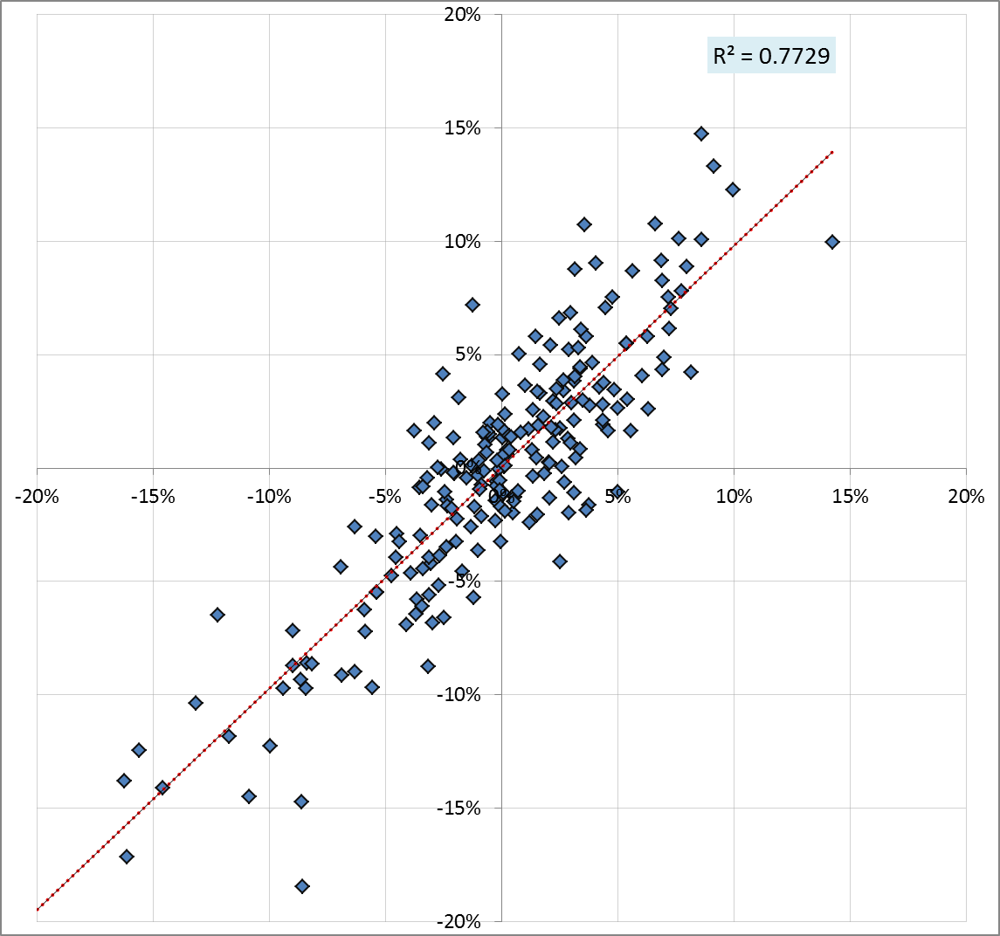
Scatter-graph of estimated measurement effects (x axis) v system effects (y axis) – Community Life
Notes:
*If measurement effects were wholly responsible for system effects we would see data points tightly scattered widely around the line of equality, with only random sampling and measurement errors preventing perfect equality.
*In this case, we have pretty tight alignment; the overall R2 is .73. Given the power of the study we wouldn’t expect it to be higher than .90 even if all of the system effect was due to measurement effects.
*Certainly not claiming that – I’m sure there are some selection effects here, just not very big ones!

Slide 25
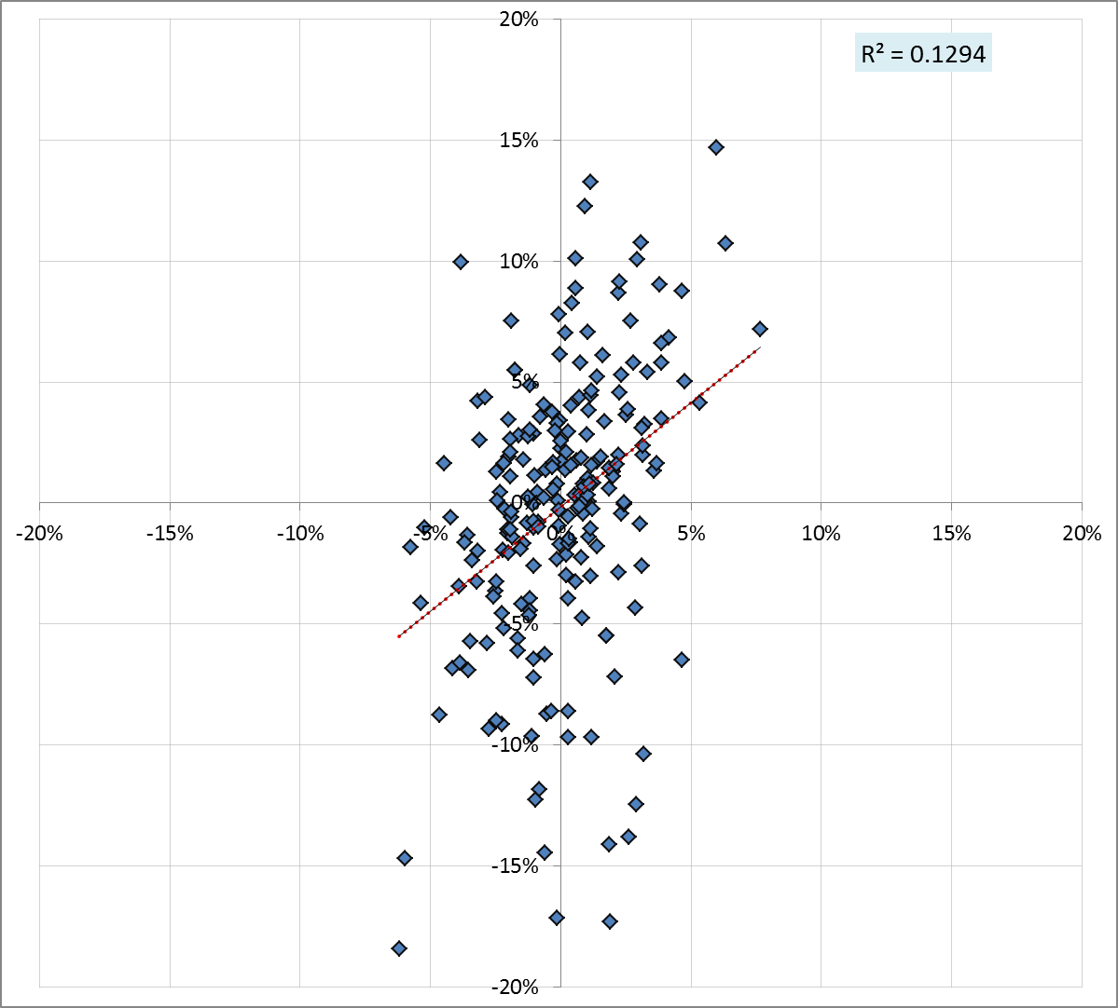
Scatter-graph of estimated selection effects (x axis) v system effects (y axis) – Community Life
Notes:
*To complete the set, here are the selection effects, plotted on the same graph. R2 is much smaller (.13 compared to .73) and this is closer to what we might expect if selection effects had little or no contribution to system effects, at least in the aggregate.
*Note that the largest selection effect is about 7 percentage points whereas largest measurement effect was over twice that.

Slide 26
Q7: How much does it cost?
Specific combination of design features that is adopted will influence cost (of course!)
For general population surveys, costs have (so far) been 50-70% of dual-frame RDD and 15-20% of f2f interview surveys but ABOS is much more expensive than (convenience sample) online panel surveys
Surveys specifically of subpopulations more expensive per eligible complete but sometimes able to use auxiliary address data to improve efficiency
Community Life now incorporates an ethnic minority population boost purely through applying different sample fractions for different strata
Potential to use address-level admin data - or data from vendors like Experian/CACI - to improve efficiency
Piloting essential due to wide variation in response rates
Notes:
*RDD has recently become more expensive due to decreased strike rates (interviews per hour of work) and wages generally set to ensure a minimum of the local ‘living wage’.
*Vendor data is not all that accurate but can certainly increase efficiency of subpopulation surveys where subpopulation is defined by age group.

Slide 27
‘PUSH-TO-WEB’ AND ADDRESS BASED ONLINE SURVEYING (ABOS)
Joel Williams, Kantar Public UK
November 2017

