Slide 1
What is the UK Data Service?
What data are available?
Case studies
How to find and access this data
Copyright © 2023 UK Data Service. Created by UK Data Service, University of Manchester
Notes:
Hello everyone, I’m Alle Bloom from the UK Data Service User support and training team, based in Manchester and today I’m going to talk to you about some datasets available from the UKDS that could be used to explore various aspects of deprivation.

Slide 2
What is the UK Data Service?
a comprehensive resource funded by the ESRC
a single point of access to a wide range of secondary social science data
support, training and guidance
Notes:
So the UKDS is a comprehensive resource funded by the ESRC and we provide access to the largest collection of social, economic and population data in the UK.
Data providers deposit their data with us and then we make this available to users.
As well as this, in the training team we provide support, training and guidance to help researchers find, access and use this data.

Slide 3
Who is it for?
Academic researchers and students
Government analysts
Charities and foundations
Business consultants
Independent research centres
Think tanks
Notes:
So, who’s it for?
Well, we like to say it’s for everyone [read a bit off slide]

Slide 4
Sources of data
Official agencies – mainly central government
International statistical time series
Research institutions
Individual academics - research grants
Market research agencies
Public records/historical sources
Notes:
And our data comes from many different sources - such as [read off slide]

Slide 5
Types of data collections
Survey microdata
Cross-sectional
Longitudinal
Aggregate statistics
International data
Census data
Qualitative and mixed methods data
Notes:
And we hold data of all different types - mostly survey data, both cross-sectional and longitudinal, aggregate data, international macrodata, census data and qualitative and mixed methods data.

Slide 6
How to find and access data from the UKDS 5
Catalogue search tool
Browse data pages
Theme
Data type
Teaching data
Variable and question bank
Qualibank
HASSET Thesaurus
Notes:
Finally, we have the HASSET thesaurus

Slide 7
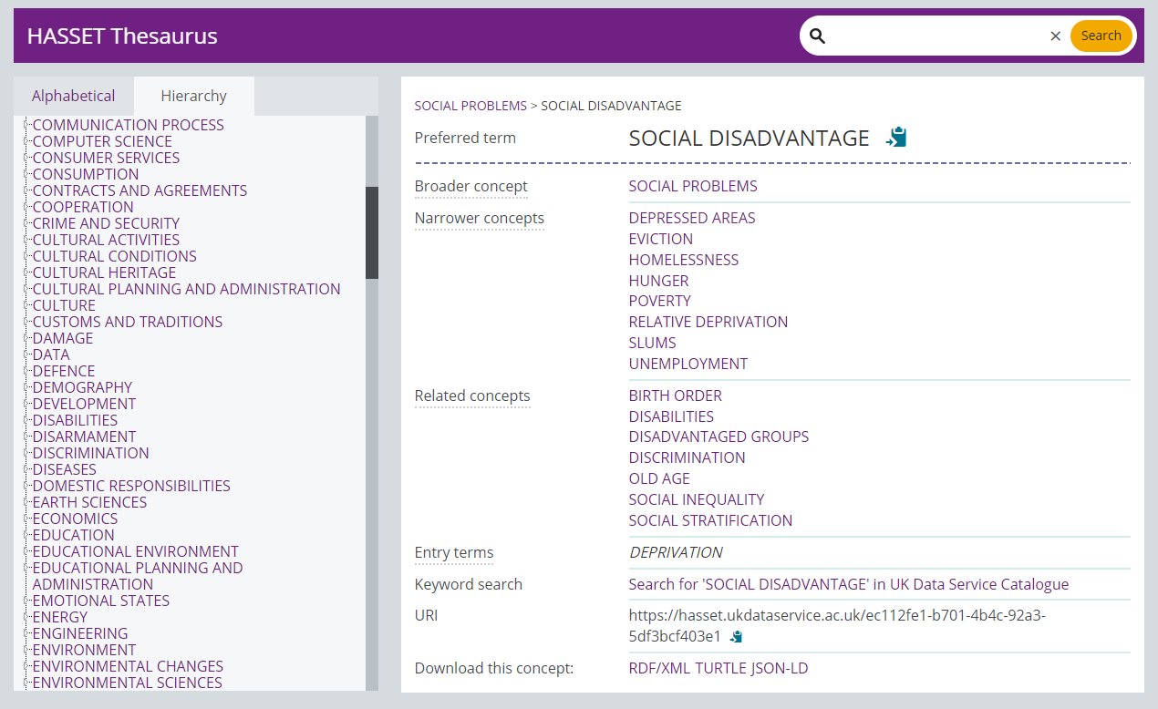
UKDS HASSET Thesaurus
Notes:
This search tool contains key social science terms and related concepts - for example here, deprivation is categorised under Social Disadvantage and you can conduct a search for this key term in the catalogue too.

Slide 8
Data Access Policy
Controlled data
Accessed via a Safe Room, SecureLab within the UK or the SafePod Network
Safeguarded data
End user licence (requires registration) and special licence (requires a form)
ReShare data
Access controls set by the data owner and can vary
Open data
Can be used by all without registering
Notes:
And just a quick point on the different data access levels.
So we have controlled data, also called secure access data, one of the most restricted types, which can only be accessed through a Safe Room, SecureLab within the UK or the SafePod network.
Safeguarded data which is EUL and requires registration, and also under this we have special licence data which has additional requirements. There’s also ReShare data, which is self-depositied access controls vary.
And then open data, which I mentioned earlier can be accessed by anyone without the need to register.

Slide 9
How to register
Logging in via OpenAthens or Shibboleth
UK Universities
Some further education colleges
Some UK Government departments
Local authorities
UK Data Archive username
International researchers
Charities
Think tanks
Schools
Personal researchers
Commercial organisations
Notes:
Finally, most of the data in our collections can be accessed free of charge, you simply need to register using your institutional log in. Or if you don’t have one, you can apply to get a UKDA username.

Slide 10
Thank you.
Alle Bloom
alle.bloom@manchester.ac.uk
Notes:
Thanks all for listening and let me know if you have any questions.

