Slide 1

Introduction
What is the UK Data Service?
What data are available?
How to find and access this data
Copyright © 2023 UK Data Service. Created by UK Data Service, University of Manchester
Notes:
Hello everyone.
I’m Dr Jools Kasmire from the UK Data Service Computational Social Science training team, based in Manchester.
Today I’m going to talk to you about The UK Data Service and how it can contribute to an exploration of COVID-19.
I’m going to start by giving a quick summary of what the UKDS is.
Then I’m going to give an overview of the data we hold and finally I’ll show you how to get started finding and accessing our data.

Slide 2
What is the UK Data Service?
a comprehensive resource funded by the ESRC
a single point of access to a wide range of secondary social science data
support, training and guidance
Notes:
The UKDS is a comprehensive resource funded by the Economic and Social Research Council, one of the many funded by UK Research and Innovation.
As such, we provide access to the largest collection of social, economic and population data in the UK.
Data providers deposit their data with us and then we make this available to users.
As well as providing access to all that data, the UKDS provides support, training and guidance to help researchers find, access and use this data.

Slide 3
Who is it for?
Academic researchers and students
Government analysts
Charities and foundations
Business consultants
Independent research centres
Think tanks
Notes:
So, who’s it for?
Well, we like to say it’s for everyone! This includes but is not limited to [read a bit off slide]

Slide 4
Sources of data
Official agencies – mainly central government
International statistical time series
Research institutions
Individual academics - research grants
Market research agencies
Public records/historical sources
Notes:
And our data comes from many different sources - such as [read off slide]

Slide 5
Types of data collections
Survey microdata
  Cross-sectional
  Longitudinal
Aggregate statistics
International data
Census data
Qualitative and mixed methods data
Other
Notes:
And we hold data of all different types - mostly survey data, both cross-sectional and longitudinal.
We also hold aggregate data, international macrodata, census data and qualitative and mixed methods data as well as a few things that don’t fit any of these categories very well.
So now I’ll just quickly cover how you can find and access all of these data from the UKDS.

Slide 6
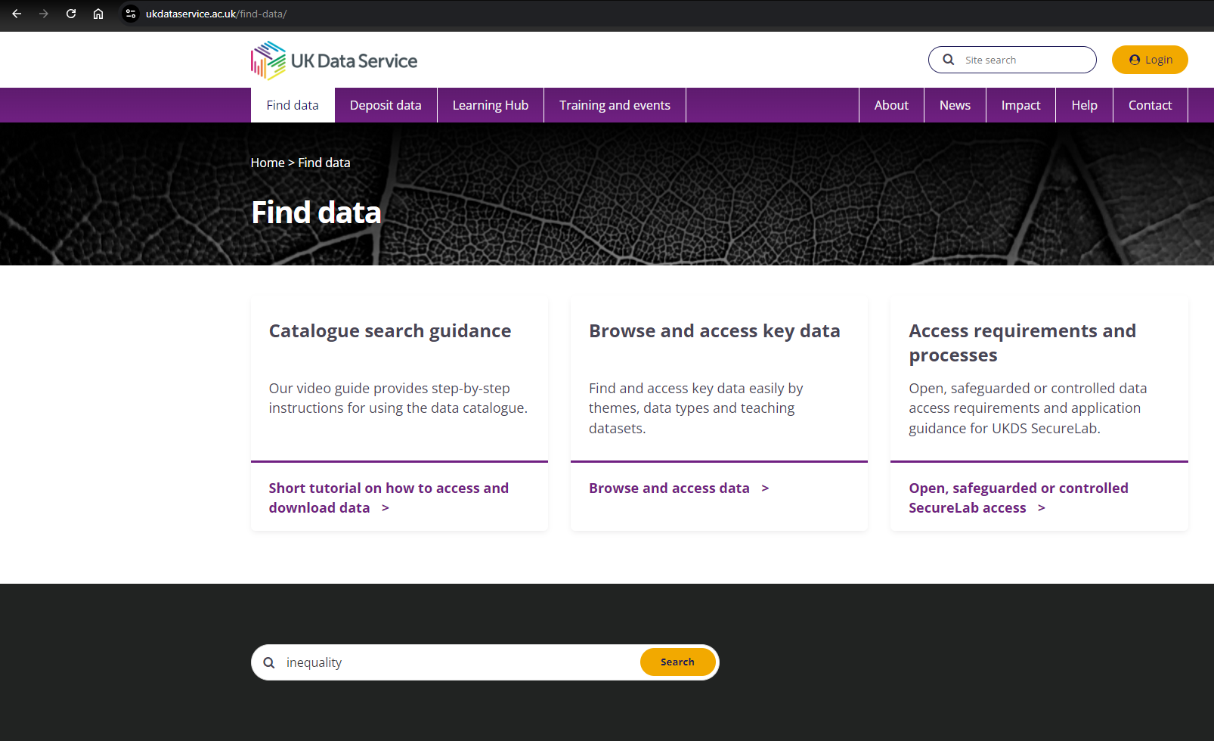
Find Data Tab
Notes:
If you don’t know how to get started, you can click on the “Find data” tab at the top which directs you to a few common options as well as some links to tutorials to learn more.
We’ll come on to the catalogue search later, but first let’s start by browsing.

Slide 7
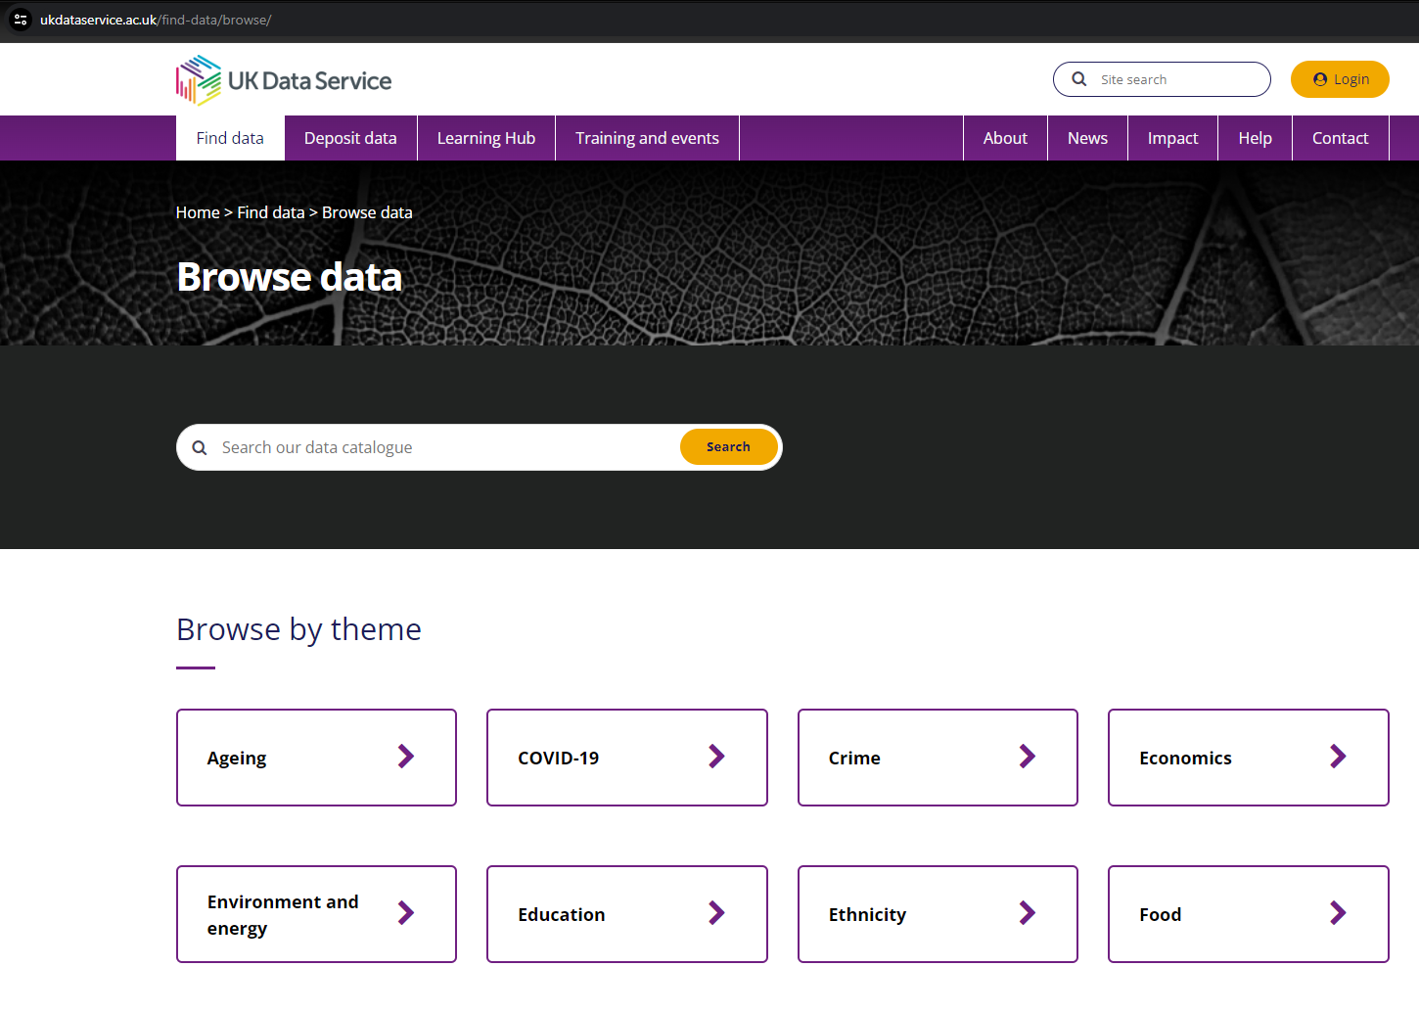
Browse by theme
Notes:
Theme is the first browsing option presented to you. Inequality is not a theme in its own right, but some of the themes are clearly relevant, such as economics, education or ethnicity.
There are more themes if you scroll down… But if you KEEP scrolling down you find…

Slide 8
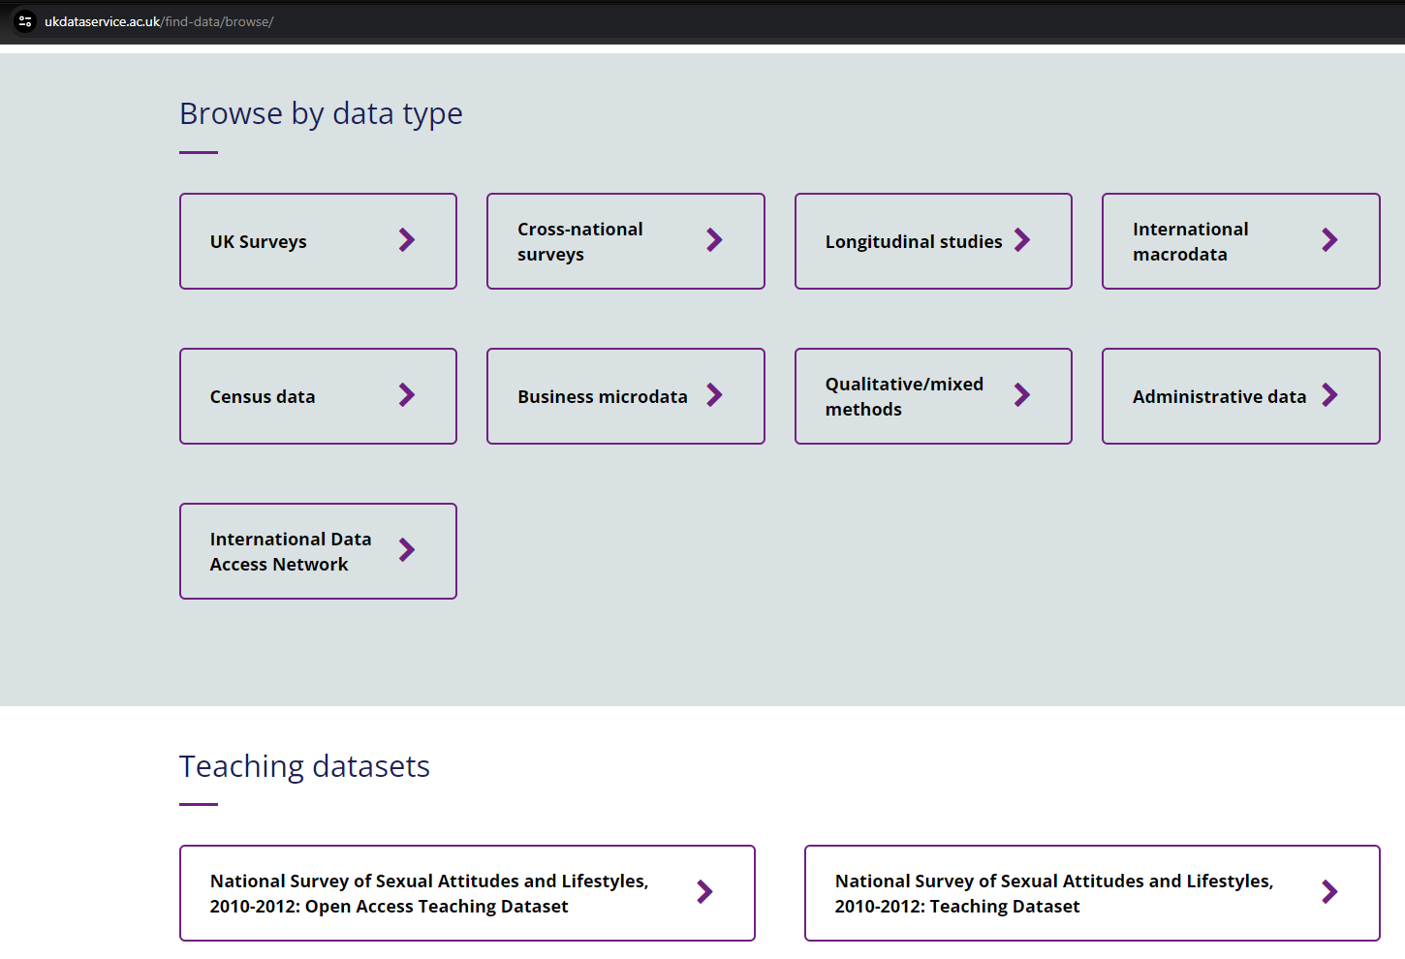
Browse by type
Notes:
You can also browse by data type. Keep scrolling down EVEN more to …

Slide 9
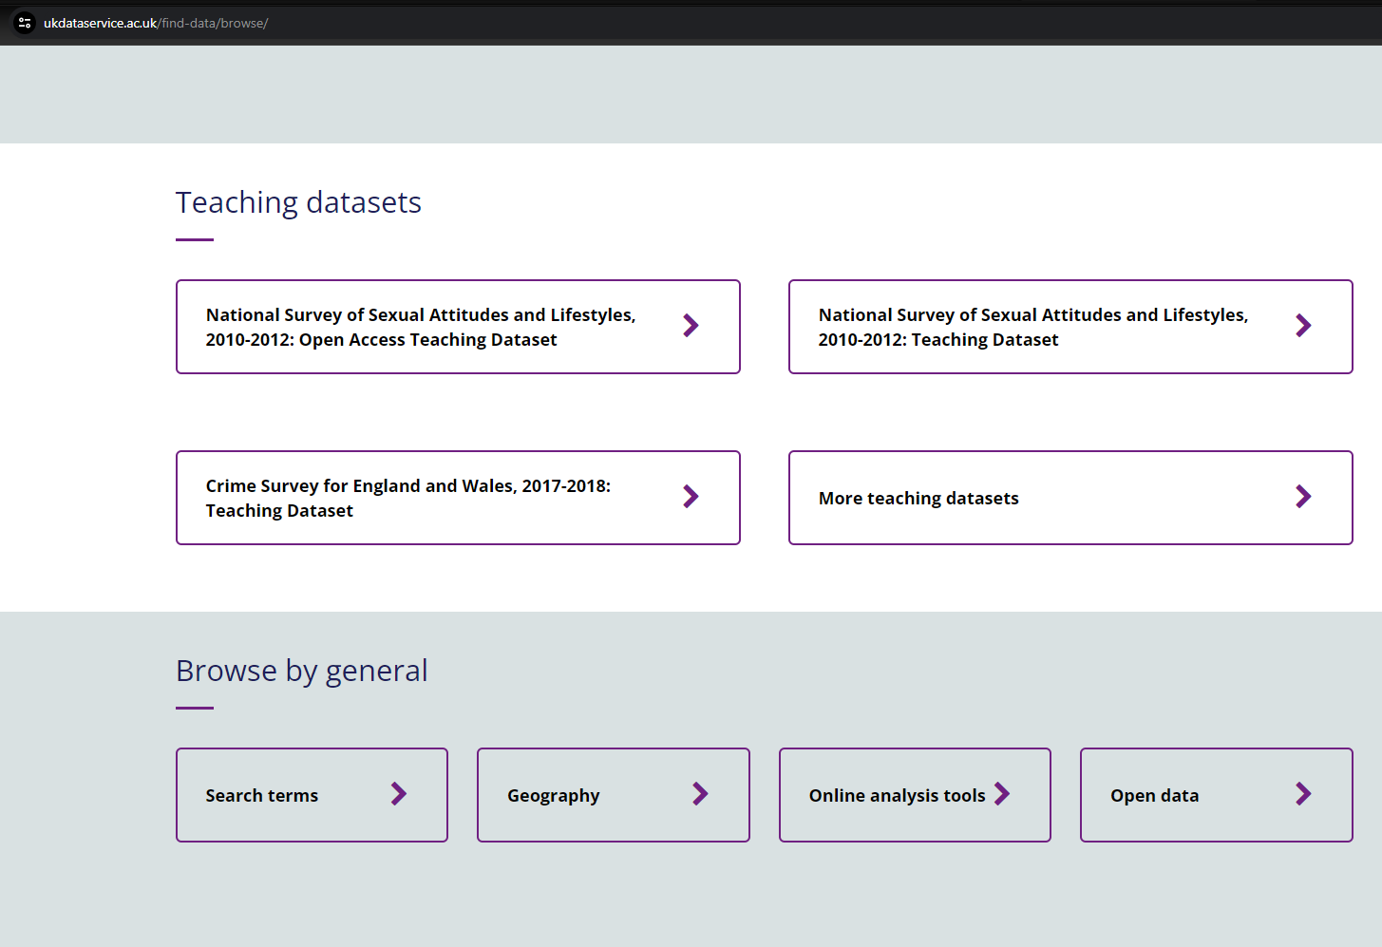
Browse teaching datasets
Notes:
Brows by teaching datasets and a few other categories that we have grouped together under ‘general’.

Slide 10
Find Data Tab
Notes:
Ok, we are back at the Find Data tab and this time we are ready to search the catalogue. You can find some guidance on how to search, but a good option is just to enter a keyword in the search bar and hit search. In this case, I entered ‘inequality’.
This same search bar is on the UKDS homepage, but wherever you start your search you will get…

Slide 11
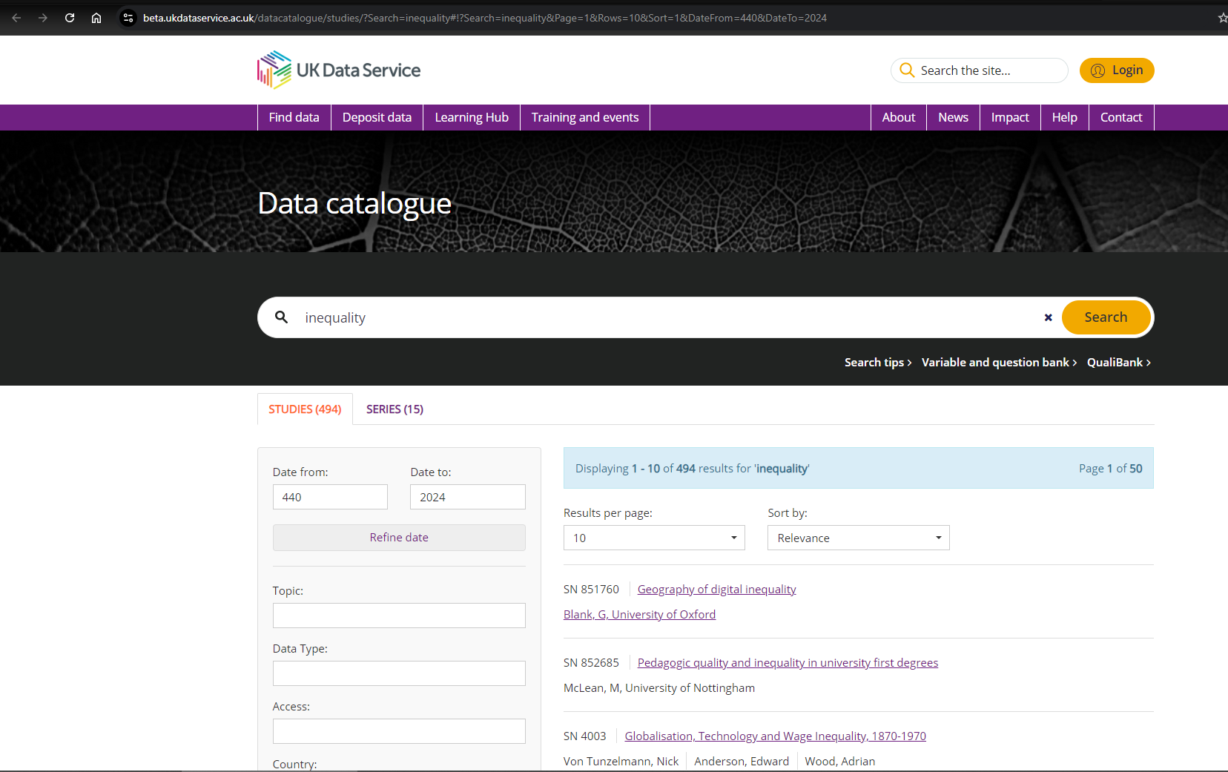
Catalogue Search Tool
Notes:
Some results for data!
The catalogue search tool is our most popular way to find data because it is not only intuitive to search by keyword or topic but you can also search for data by study name or number.
When you have results, you can refine them using these filtering options on the left hand side.
Next, I recommend you check the variable and question bank which you can access in a few ways, the easiest from here is just under the search bar.

Slide 12
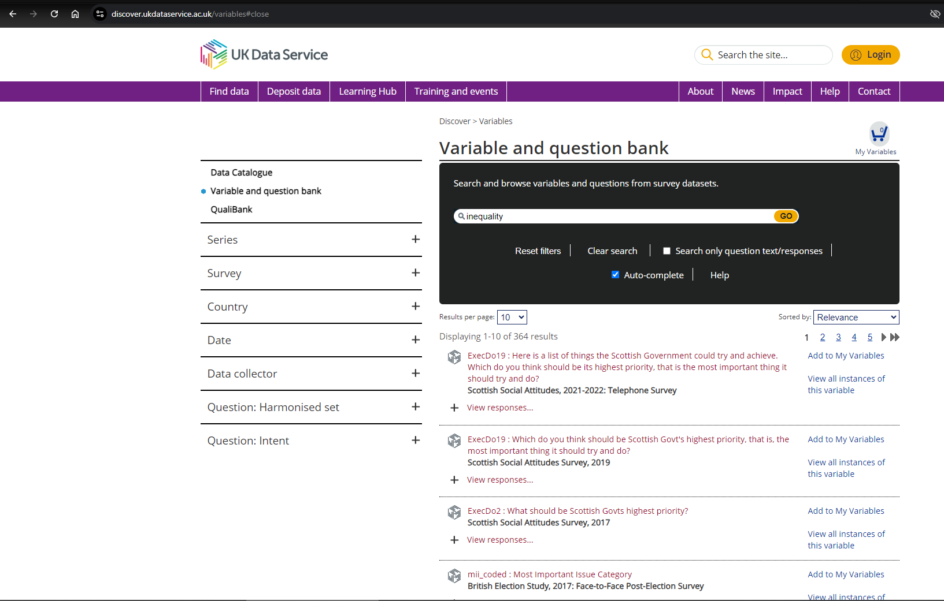
Variable and Question Bank
Notes:
You can also search for particular variables within datasets in our variable and question bank. For example, if we type in ‘inequality’ we can see which datasets contain variables on this topic. Just a note on the VAQB though, this doesn’t contain all of the datasets we currently hold, so it’s worth searching the catalogue for later versions of datasets to double check.
The options on the left-hand side here that you can expand with these little plus signs are specific to the variable and question bank. This becomes clear if you instead choose to search instead…

Slide 13
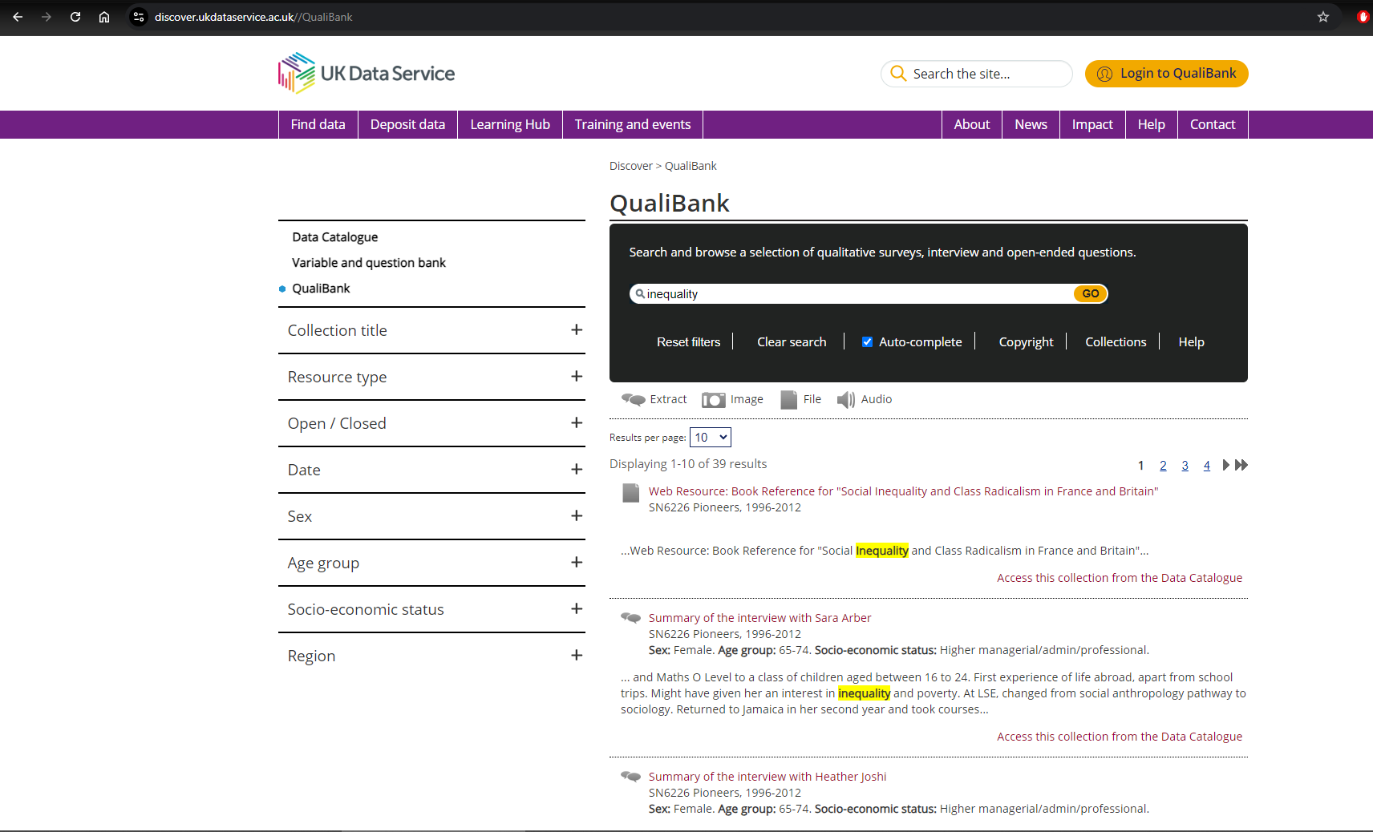
Qualibank
Notes:
In the qualibank. This is especially useful if you are interested in Qualitative data as it allows you to search key terms within different types of qualitative resources.

Slide 14
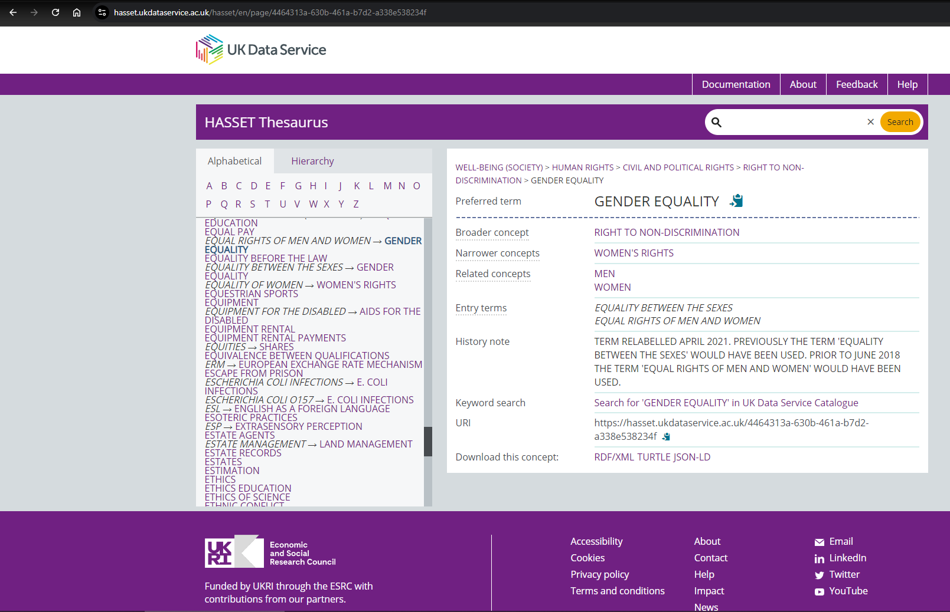
HASSET
Notes:
Finally, we have the HASSET thesaurus. HASSET stands for Humanities and Social Science Electronic Thesaurus, for those to whom it may not be obvious.
This search tool contains key social science terms and related concepts - for example here, EQUALITY is categorised under RIGHT TO NON-DISCRIMINATION which is itself under CIVIL AND POLITICAL RIGHTS, under HUMAN RIGHTS, under WELL-BEING (SOCIETY). which is clear when you look at this tool via the hierarchy tab.
Alternatively, you can look at the thesaurus through the alphabetical tab, which is pretty self-explanatory.
The thesaurus is helpful to show you what other terms might be useful to search in the catalogue, either because they fall higher or lower in the hierarchy or because they are listed under the related concepts.

Slide 15

Data Access Policy
Controlled data
Accessed via a Safe Room, SecureLab within the UK or the SafePod Network
Safeguarded data
End user licence (requires registration) and special licence (requires a form)
ReShare data
Access controls set by the data owner and can vary
Open data
Can be used by all without registering
Notes:
And just a quick point on the different data access levels.
Starting at the most restricted types, we have controlled data which is also called secure access data. This data can only be accessed through a Safe Room, SecureLab within the UK or the SafePod network.
Next, we have safeguarded data which is available through End User License. Access to this kind of data requires registration. Some of this data is also special licence data which has additional requirements.
There’s also ReShare data, which is self-depositied by data creators or owners. Access to and controls on this kind of data can vary.
Finally, the least restricted type is open data. This is data that can be accessed by anyone, even without the need to register.

Slide 16
How to register
Logging in via OpenAthens or Shibboleth
  UK Universities
  Some further education colleges
  Some UK Government departments
  Local authorities
UK Data Archive username
  International researchers
  Charities
  Think tanks
  Schools
  Personal researchers
  Commercial organisations
Notes:
Importantly, most of the data in our collections can be accessed free of charge.
You can simply register using your institutional log in.
If you don’t have an institutional log in, you can apply to get a UKDA username.

Slide 17
Thank you.
Dr. Jools Kasmire
j.kasmire@manchester.ac.uk
Notes:
Thanks all for listening and let me know if you have any questions.

